Slide 1
Recall : Connect to MYSql 5.5 using JDBC 4.0
java.sql.DriverManager supports the service provider mechanism. What is service provider mechanism?
JDBC 4.0 has this feature that JDBC drivers can use which allows them to announce themselves by providing a META-INF/services/java.sql.Driver file that are automatically discovered, loaded and registered.

Slide 2
Connecting to a database
We can connect to database from our servlet in two ways:
Connect to database directly
Without using service provider mechanism
Using JBDC 4.0 service provider mechanism
Using DataSources

Slide 3
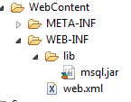
Connecting to MySQL
The code to connect to database is same as what we have seen in JDBC section while connecting from standalone java application.
The MYSQL jar file must be added in the WEB-INF\lib. This can be done by simply copying the file and dropping into the project into eclipse IDE.

Slide 4
Code
protected void doGet(HttpServletRequest request, HttpServletResponse response) throws ServletException, IOException {
Connection conn = null;
PrintWriter out = response.getWriter();
out.println("<html><head><title>init param </title></head><body> hello");
try
{
String userName = "root";
String password = "root";
String url = "jdbc:mysql://localhost/test";
Properties props = new Properties();
props.put("user", userName);
props.put("password",password);
Class.forName ("com.mysql.jdbc.Driver");
conn = DriverManager.getConnection(url,props);

Slide 5
Statement s= conn.createStatement();
ResultSet rs=s.executeQuery("SELECT * FROM STUDENT");
System.out.println("ID Name Degree Semester");
while (rs.next() ) {
out.println(rs.getInt(1) +” "+rs.getString(2)+ “"+rs.getString(3)+“ “+rs.getInt(4)+"</body></html>");
}} catch (Exception e){
out.println("Failed"+ e);}
finally {
if (conn != null) {
try {
conn.close ();}catch (SQLException e) {
}
} }
}

Slide 6
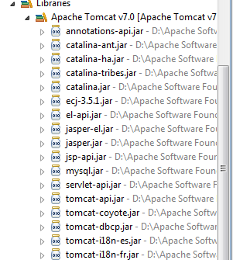
Connecting to MySQL JDBC 4.0 way
Tomcat 7.0 scans for database drivers through libraries visible to the <Tomcat_base_folder>/lib.
Hence MYSQL jar file that contains META-INF/services/java.sql.Driver file must be copied to the <Tomcat_base_folder>/lib.
The same code in the previous slide without
Class.forName ("com.mysql.jdbc.Driver");
now works because the class is automatically discovered, loaded and registered

Slide 7
JDBC 2.0 optional package
javax.sql package
Includes the following:
DataSource interface
Connection Pooling
Distributed Transactions
RowSet

Slide 8
DataSource
DataSource interface is used as an alternative to DriverManager of JDBC 2.0 core package.
It makes the application more portable and makes the code easier to maintain.
A DataSource object refers to the real world data source (relational database or spreadsheet etc.)
DataSource object is created (typically by an application server) when the details like the URL of the data source and the Driver name is provided.

Slide 9
JNDI and DataSources
DataSource object thus created is then registered with a JNDI naming service (which maps the DataSource object with a name).
Once this is done, any application can retrieve the DataSource object from the JNDI naming service by providing the name.
Once the DataSource is obtained, the Connection object can be created and from then on the code can work with JDBC 2.0 core package as usual.

Slide 10
Steps to get Connection object from DataSource
Step 1: Get the DataSource object
Context ctx=new InitialContext();
DataSource ds= (DataSource ) ctx.lookup(“jdbc/MyDSName”);
Step 2: Get the connection object
Connection con= ds.getConnection(“username”,”password”);

Slide 11
Advantages
Portability: Since the information such as the URL of the data source location, Driver class name is not hard-coded in the application, it makes the application independent of database (or data source) vendor.
Easy Maintenance: If the url of data source changes then it just involves making one change in data source configuration. Application need not be touched at all!
Connection Pooling
Explained in the next slide

Slide 12
J2EE Application Server’s support for DataSource
J2EE Application Server comes with some JNDI naming and directory services (LDAP Server etc.).
Most Application Servers provide a tool that allows application developers or administrators to configure DataSources to this JNDI service.
Advantage with this is that the application developer can defer the decision of which database to use until the deployment time!

Slide 13
Connection Pooling
Connection Pooling is a mechanism whereby a collection of connection objects is maintained by the application
Each time application requires a Connection object, it gets it from the pool.
In other words, when an application closes a connection, that connection is recycled rather than being destroyed. This improves the performance.
Most JEE application servers implement DataSource interface that supports connection pooling.
Therefore when you get DataSource instance, you get it from the pool and when you close it, the connection goes back to the pool.
The size of the connection pool depends on the application server.
Application servers also provide a tool where this size can be configured.

Slide 14
Tell me how
How does Connection pooling improve performance?
Establishing connection is an expensive operation. If connection to a data source is required throughout the application, it is wise to retain and reuse the same connection object. In a web application (where many clients request at the same time) it makes sense to create a pool of connection objects and reuse these!

Slide 15
Distributed Transactions
From an application developer’s point of view there is no difference between Connection obtained by the DataSource object and the DriverManager except in case of transactions.
With Connection object obtained from DataSource, distributed transaction is automatically supported.
Therefore the application using Connection object obtained from DataSource cannot call commit or rollback methods directly.

Slide 16
Steps to work with DataSource in Tomcat7.0
Create a web application with web.xml file.
Create a configuration file for DataSource
Add <resource-ref> in web.xml
Add libraries
Write code to connect to the database

Slide 17
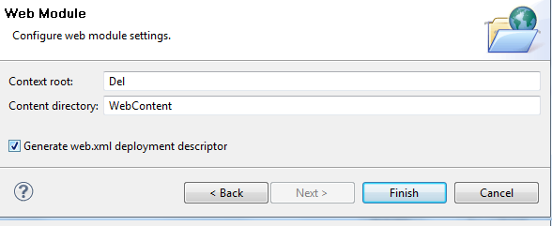
Create a web application with web.xml file
The steps to create a new web application with web.xml file is same as that of creating a new Dynamic Web Project, except that when creating use Next buttons until you find a page where a checkbox “Generate web.xml deployment descriptor” . Tick this checkbox and Finish.

Slide 18
Configuring DataSource in Tomcat
2 ways to configure DataSource
Add context.xml in the individual web application inside META-INF folder.
Recommended way
When running from Eclipse WTP extra configuration needs to be done on the server configuration file.
add <Context> in the server.xml file in Tomcat conf folder.
Used when database is commonly accessed my multiple applications

Slide 19
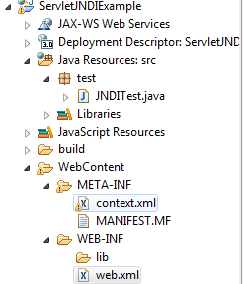
1. context.xml in individual application
Create a context.xml file inside META-INF of your web application.
<?xml version="1.0" encoding="UTF-8"?>
<Context docBase="/ServletJNDIExample"
path="ServletJNDIExample" reloadable="true">
<Resource name="jdbc/Test"
auth="Container"
type="javax.sql.DataSource"
maxActive="100"
maxIdle="30"
maxWait="-1"
username="root"
password="root"
driverClass="com.mysql.jdbc.Driver"
url="jdbc:mysql://localhost/test">
</Resource>
</Context>
web application context
JNDI name
Configuration with respect to MySQL

Slide 20
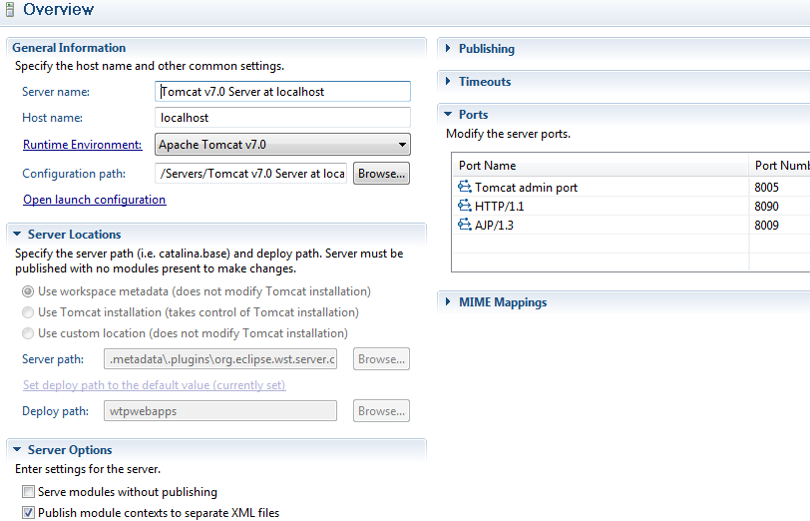
Configuring server file in Eclipse WTP
Double click on the Tomcat v 7.0 Server in the server panel .
Select "Publish module contexts to separate XML files" option.

Slide 21
2. Configuration in server.xml
Add the same <Context> content in server.xml file found in conf folder of tomcat.
Move right down the file until you find </Host>
Add the following just above the </Host> tag
<Context docBase="/ServletJNDIExample" path="ServletJNDIExample" reloadable="true">
<Resource name="jdbc/Test" auth="Container" type="javax.sql.DataSource"
maxActive="100" maxIdle="30" maxWait="-1"
username="root" password="root" driverClass="com.mysql.jdbc.Driver"
url="jdbc:mysql://localhost/test">
</Resource>
</Context>

Slide 22
Add <resource-ref> in web.xml
In web.xml add the following
<resource-ref>
<description>Test</description>
<res-ref-name>jdbc/Test</res-ref-name>
<res-type>javax.sql.DataSource</res-type>
<res-auth>Container</res-auth>
</resource-ref>
This tells which JNDI resources will our web application access.

Slide 23
Add libraries
Either copy the jar file for MySQL in the and drop it in the
<Tomcat_base_folder>/lib or
in the individual web application in WEB-INF/lib folder

Slide 24
Write code to connect to the database
package test;
import java.io.*;
import java.sql.*;
import javax.naming.InitialContext;
import javax.servlet.ServletException;
import javax.servlet.annotation.WebServlet;
import javax.servlet.http.HttpServlet;
import javax.servlet.http.HttpServletRequest;
import javax.servlet.http.HttpServletResponse;
import javax.sql.DataSource;
@WebServlet("/JNDITest")
public class JNDITest extends HttpServlet {
private static final long serialVersionUID = 1L;

Slide 25
protected void doGet(HttpServletRequest request, HttpServletResponse response) throws ServletException, IOException {
Connection conn = null;
PrintWriter out = response.getWriter();
out.println("<html><head><title>JNDI test </title></head><body>");
try {
/* get the DataSource from using the JNDI name */
InitialContext ctx = new InitialContext();
DataSource ds = (DataSource)
ctx.lookup("java:comp/env/jdbc/Test");
/* Create connection and then continue as usual other JDBC calls */
Statement s= conn.createStatement();
ResultSet rs=s.executeQuery("SELECT * FROM STUDENT");

Slide 26
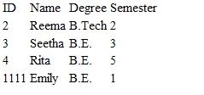
out.println("<table><tr><td>ID</td><td>Name</td>< td>Degree</td><td> Semester</td></tr> ");
while (rs.next() ) {
out.println("<tr><td>"+rs.getInt(1) +"</td><td>"+rs.getString(2)+"</td><td>"+rs.getString(3)+"</td><td>"+rs.getInt(4)+"</td></tr>");
}
out.println("</table></body></html>");
} catch (Exception e){
out.println("Failed"+ e);
}}}

Slide 27
Best Practices
In case of connecting to the database directly the configuration information like URL, username, password etc must be saved in saved in web.xml <context-param> or <init-param> instead of hard coding this in the servlet.
In case of DataSource, the DataSource JNDI name like /jdbc/Test must be saved in web.xml <context-param> or <init-param> instead of hard coding this in the servlet.
While for a small, infrequent database access, direct JDBC call are fine, but for database intensive application, DataSource should be used.
Today’s application connect to the database using technologies like EJB and Hibernate where all the JDBC calls are handled by the application server and the 3rd party classes itself. A developer needs to create just a simple Java Bean classes that will act as entities of the system.

